Slide 1
Considering Physical Variables for Data Physicalization
Welcome!
Trevor Hogan, Uta Hinrichs, Samuel Huron, Bettina Nissen
6th workshop (series): VIS’14, CHI’15, TEI’16, DRS’16, DIS’17 & DRS’18 (VIS’18)

Slide 2
Today's schedule
11:00 – 11:40 Introduction
Who are we?
Who are you? What is Physicalization?
11:40 – 12:45 Physicalization Activity: Group forming, Ideation & Design
12:45 – 1:30pm Lunch break
1:30 – 2.45pm Physicalization Activity: Design & Making
2:45 – 4.00pm Presentation of the physicalization
Discussion & Conclusion
4pm End of Workshop
RECORDING: We will record audio-visual footage during the workshop, for potential publication this will be
anonymised. If you prefer not to be recorded, let us know.

Slide 3
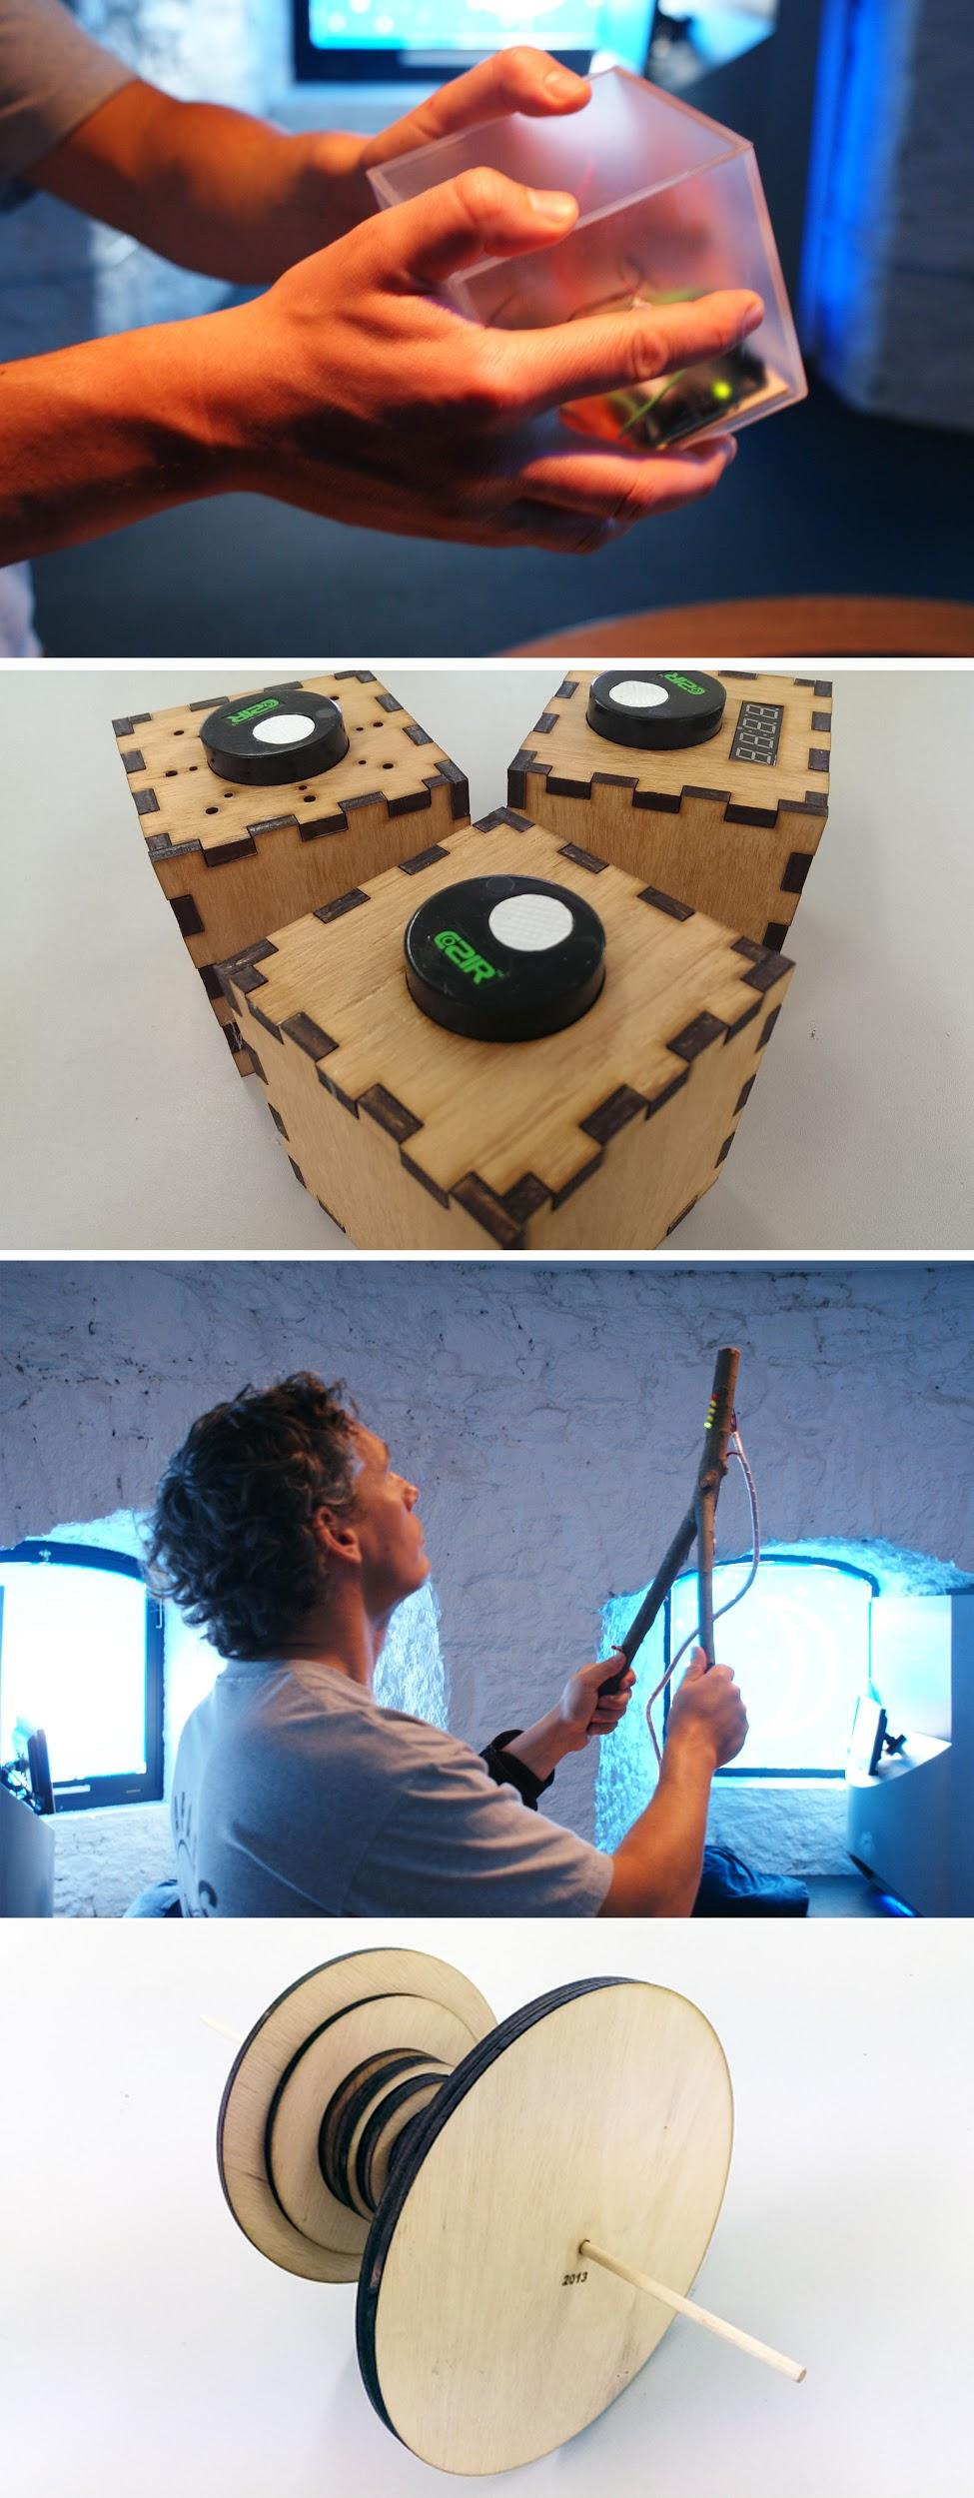
Trevor Hogan
Lecturer in Interaction Design Crawford College of Art and Design, CIT, Ireland
Human-Data Interaction Group “Extending the use representational modalities and extending evaluation criteria, methodologies and audience”
Interests # Physicalization & Multisensory Data Representations # Tangible Interaction # Data Experience # Design & Evaluation Methods
www.tactiledata.net hello@tactiledata.net @tactiledata

Slide 4
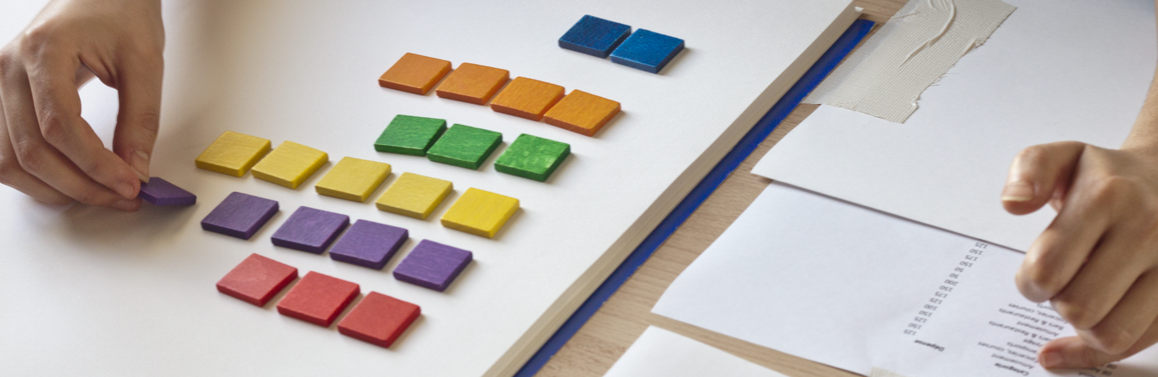
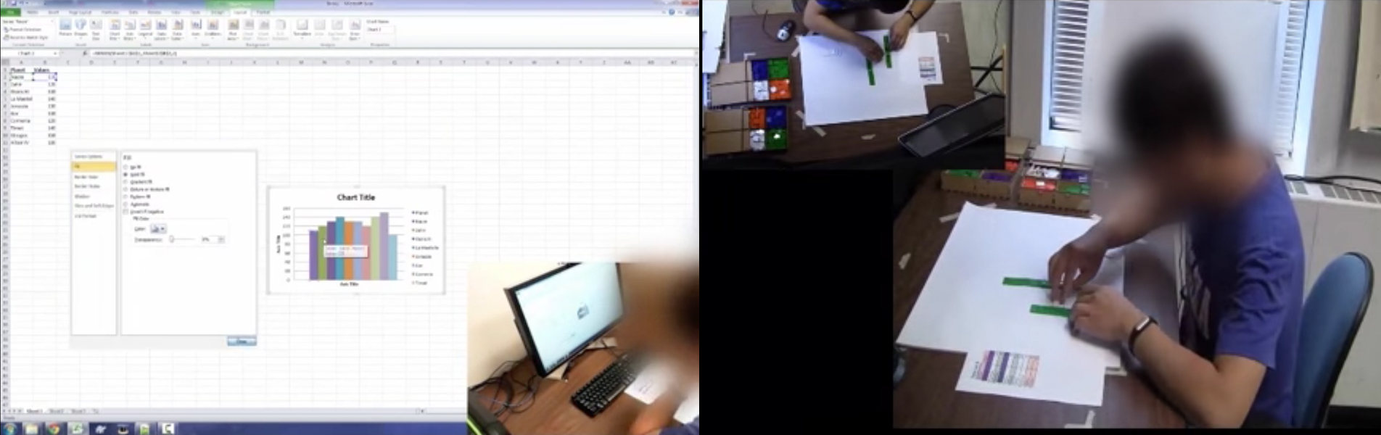
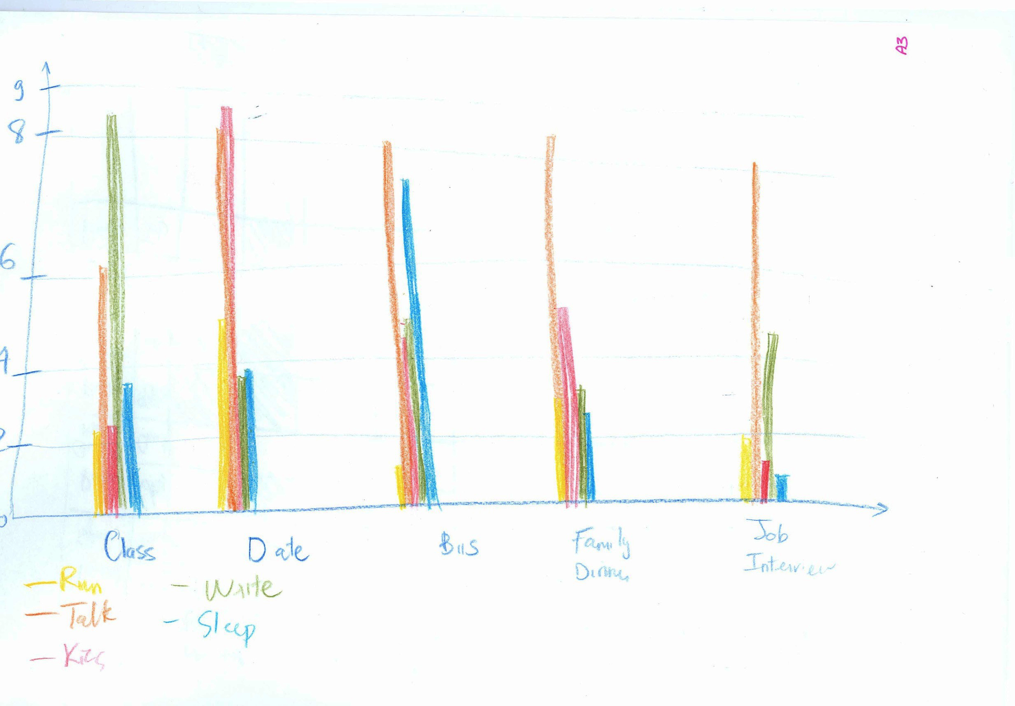
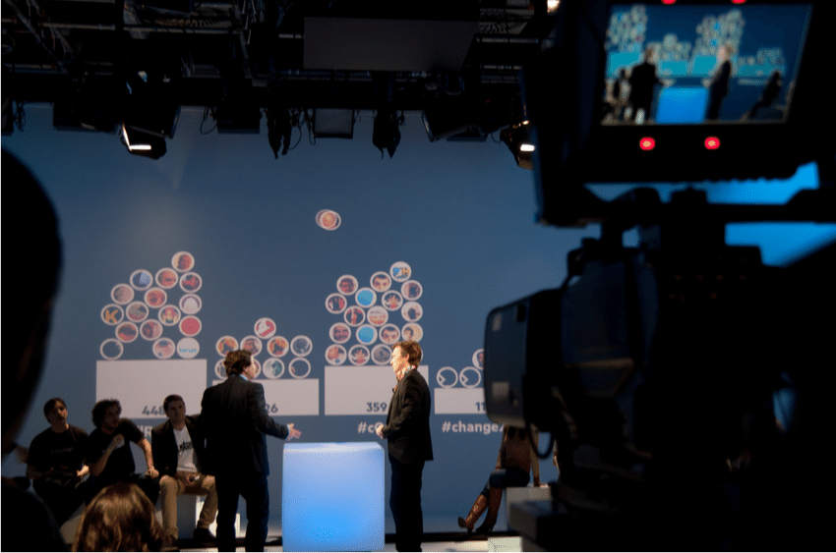



Samuel Huron
Associate professor
Design, Infovis, HCI
University of Paris Saclay Telecom Paris-Tech I3 - UMR 9217 CNRS
Interests: # Construction of vis # Information visualization # Design methods in Research # Design paradigms
Twitter : @cybunk
Understanding how physically building information representation impact the construction of people understanding.
Making visualization authoring accessible for “non visualization experts”

Slide 5
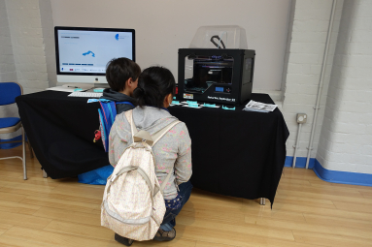
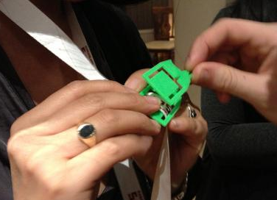

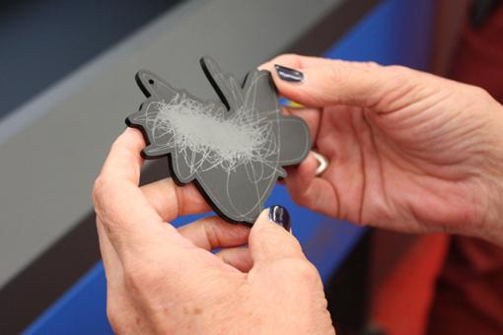
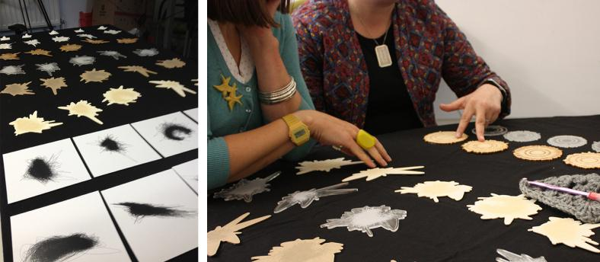
Bettina Nissen
Research Associate | Design Informatics University of Edinburgh, UK
bettina.nissen@ed.ac.uk www.data-things.com @bettinanissen
Interests Data Engagement Digital Fabrication Public Data Making Data Craft Practices Materiality

Slide 6
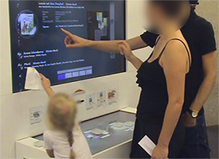
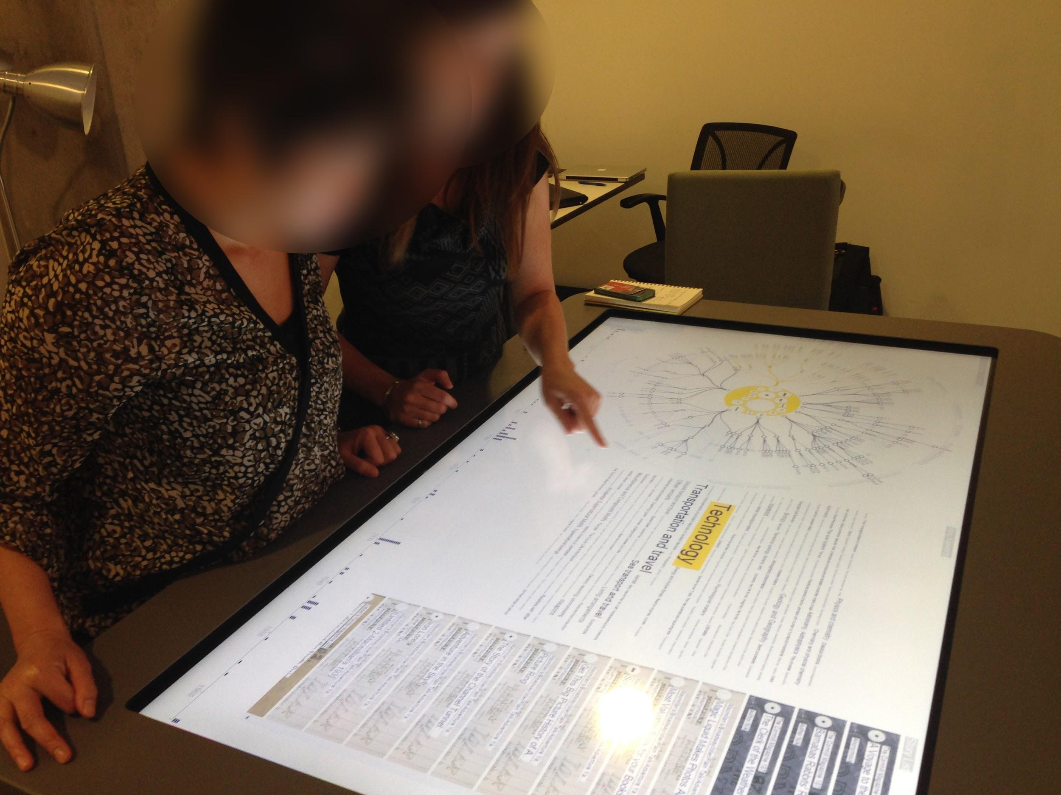
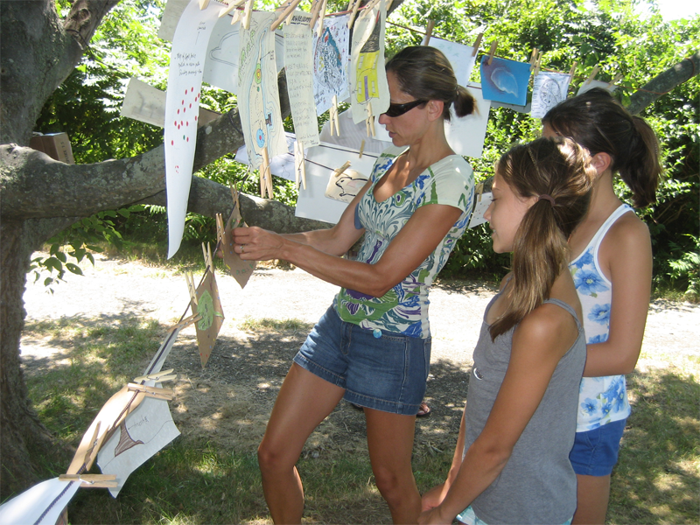


Uta Hinrichs
Assistant Professor in Human-computer Interaction & InfoVis
www.utahinrichs.de | uh3@st-andrews.ac.uk | @uta_ente
SACHI Research Group; University of St Andrews, Scotland
http://sachi.cs.st-andrews.ac.uk
Interests
# information visualization
# physical data representations
# interface design
# studying experiences with visualization
# visualization as a method to engage & facilitate a dialogue
Notes:
Making cultural collections “graspable”
Visual literacy & visualization for children

Slide 7
Who are you?
Name Affiliation Domain Why are you interested in physicalization?
In 20 seconds :-)

Slide 8
What is Physicalization?
→ Mapping data to visual / physical properties / material / forms
Notes:
What do we mean by that ?

Slide 9
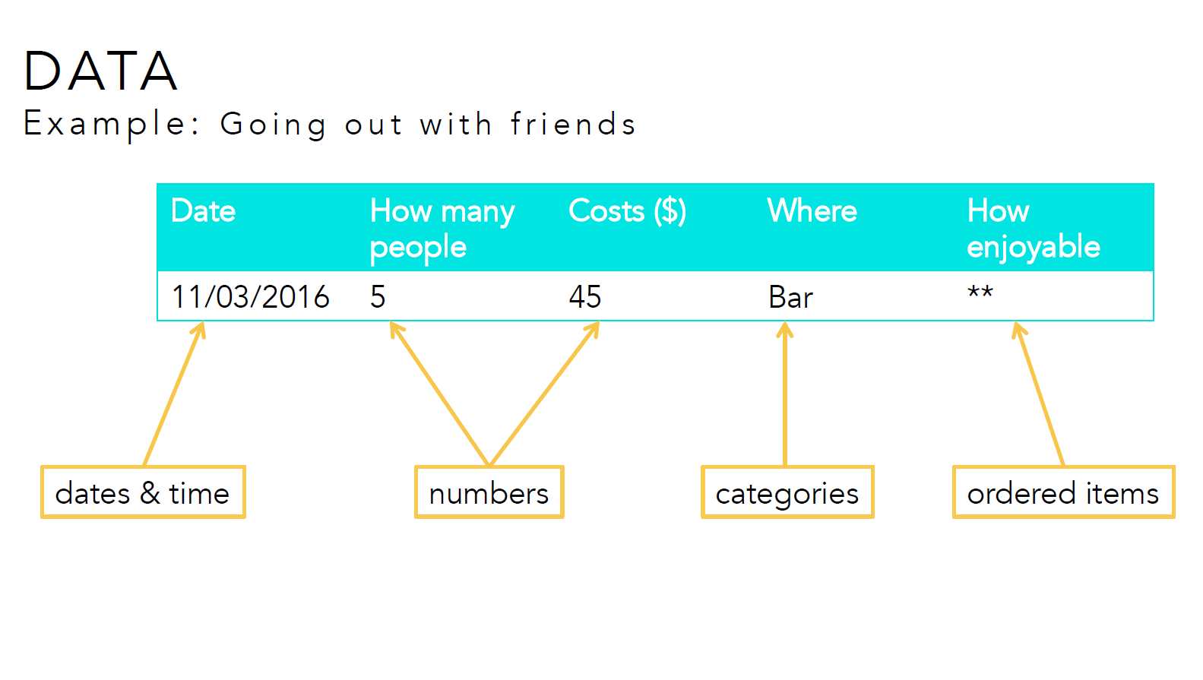
Notes:
Let’s imagine, you are logging your activity, there are different types of data you can log.
Some could be time, others could be number, or categories, and ordered items.
All these data have certains properties, Number could use for different arithmetical operation
While ordered items and categories are not

Slide 10
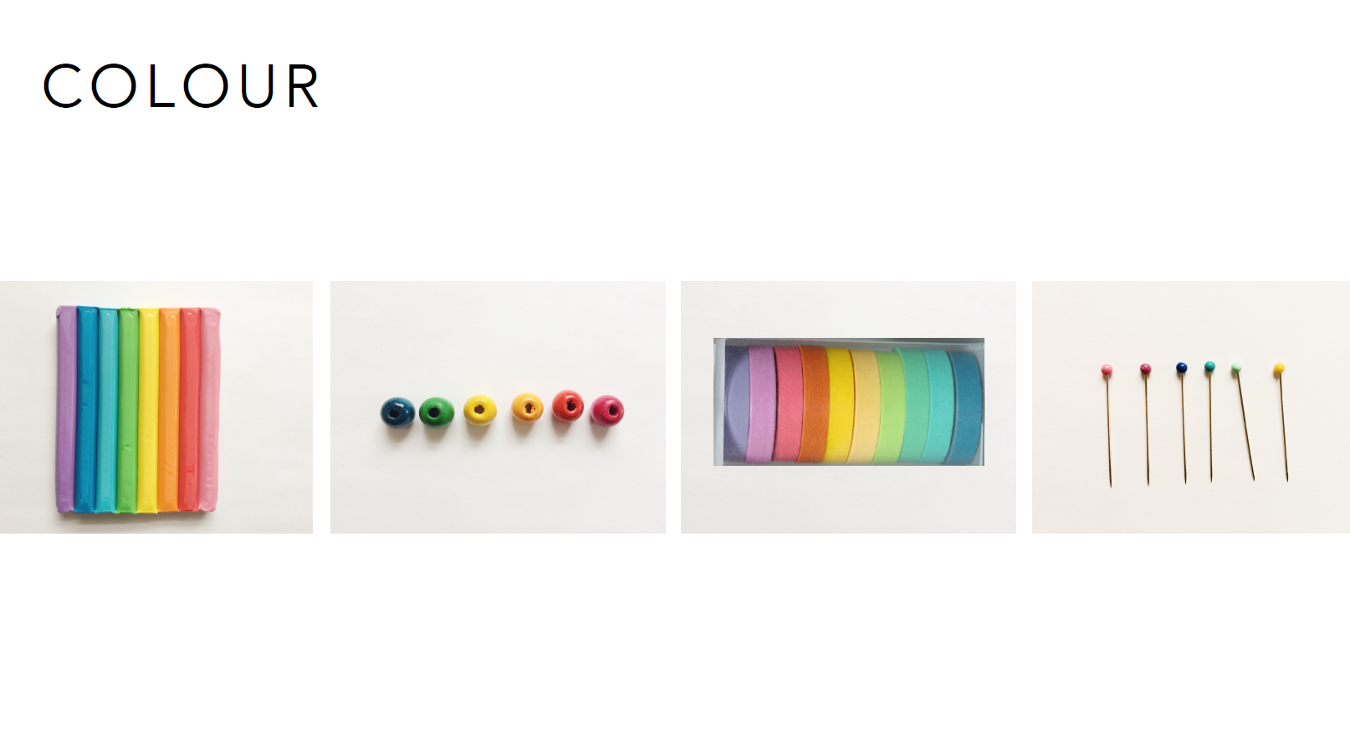
Image courtesy Alice Thudt
http://alicethudt.de/
Notes:
To represent this informations you can use colours , and it can be over different material

Slide 11
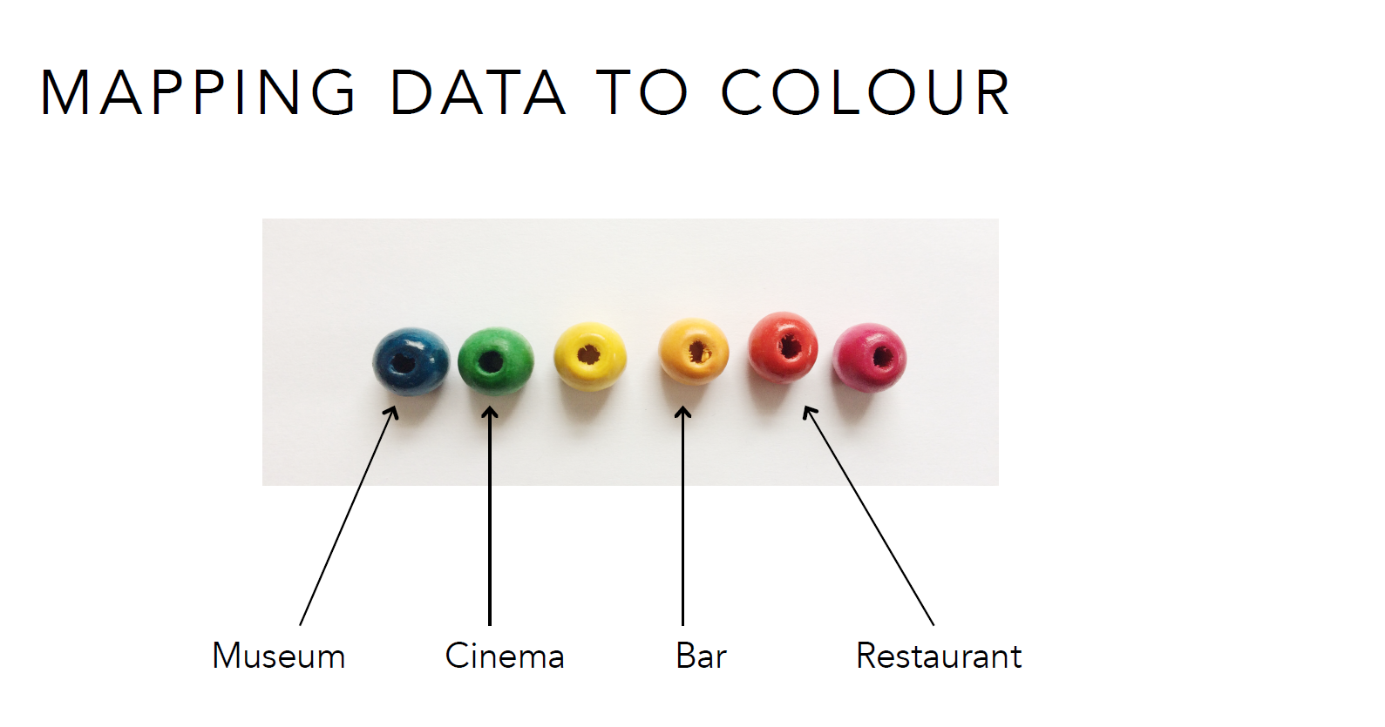
Image courtesy Alice Thudt
http://alicethudt.de/
Notes:
For instance you can map colors to categories because color

Slide 12
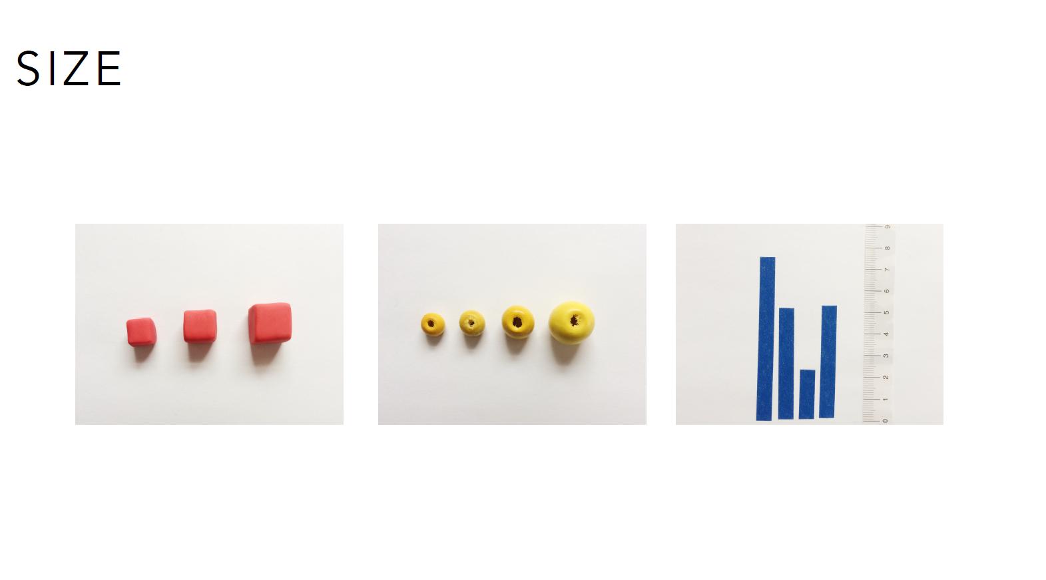
Image courtesy Alice Thudt
http://alicethudt.de/
Notes:
Size is often used as a variable to map quantitaive value like numbers.
However size could mean different things here, such as the size of an object that impact the volume
While changing the size of a paper band is only one

Slide 13
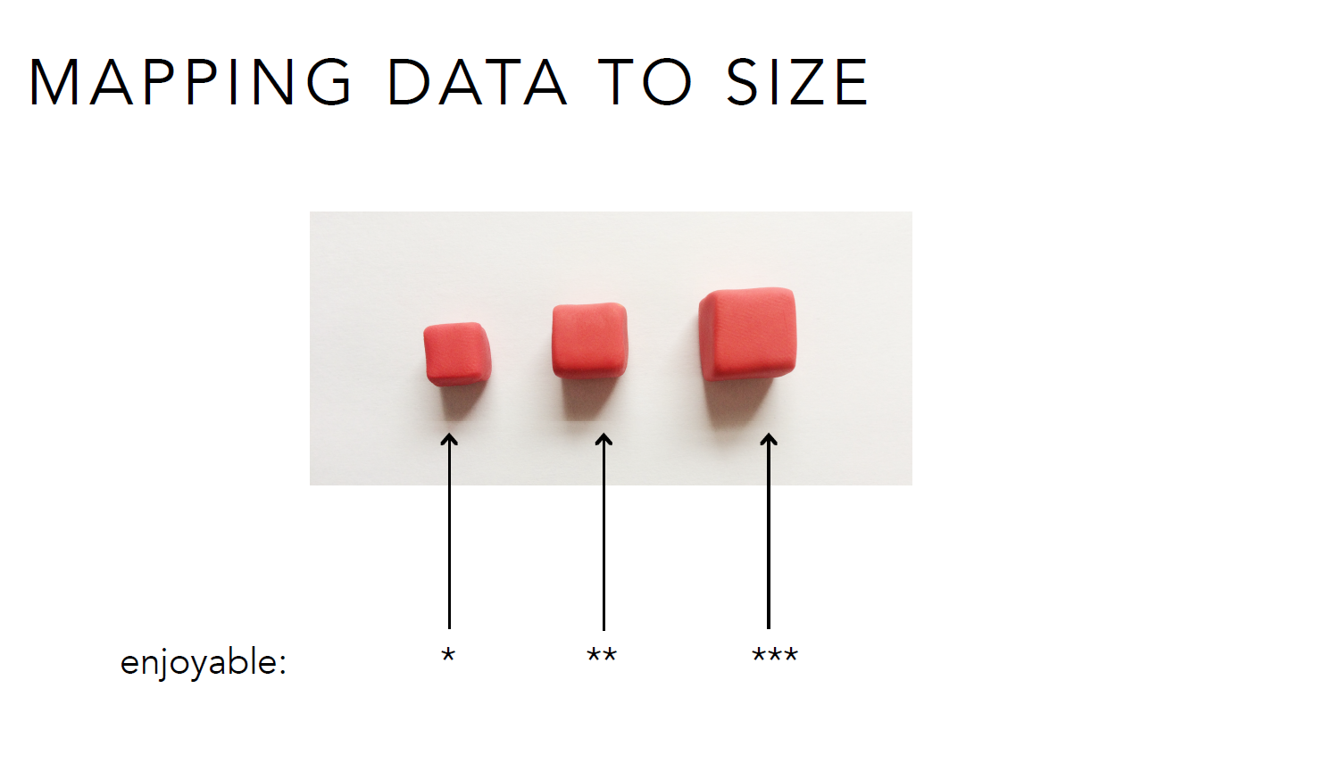
Image courtesy Alice Thudt
http://alicethudt.de/
Notes:
But we can use size to map orders also

Slide 14
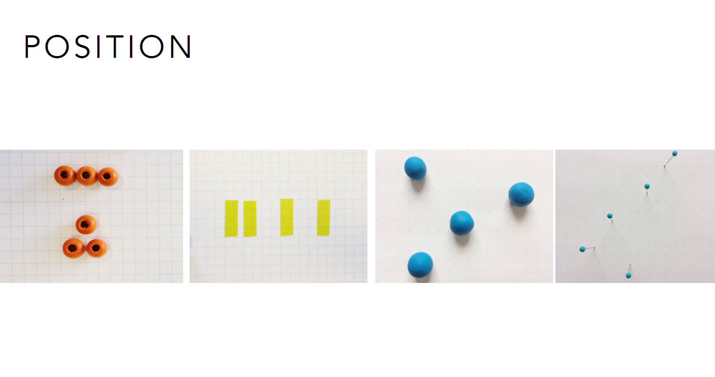
Image courtesy Alice Thudt
http://alicethudt.de/
Notes:
Position is a really powerful visual variable that is used in a lot of domain

Slide 15
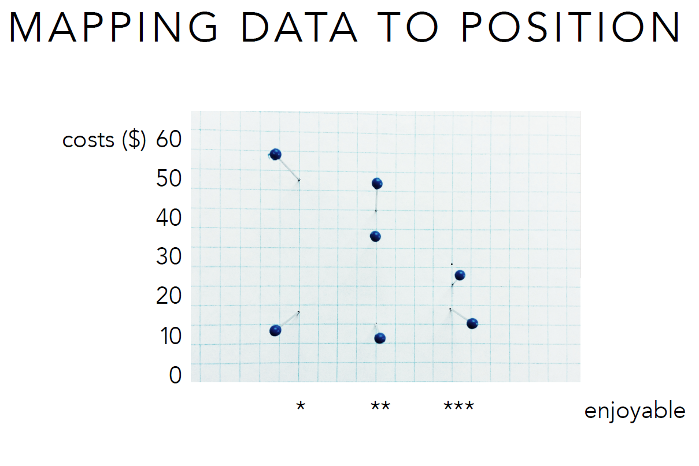
Image courtesy Alice Thudt
http://alicethudt.de/
Notes:
Position can be use on three different dimension x, y, and z , here we see a classical chart that allow to represent two dimension of the data the cost of the event and the enjoyablility of it

Slide 16
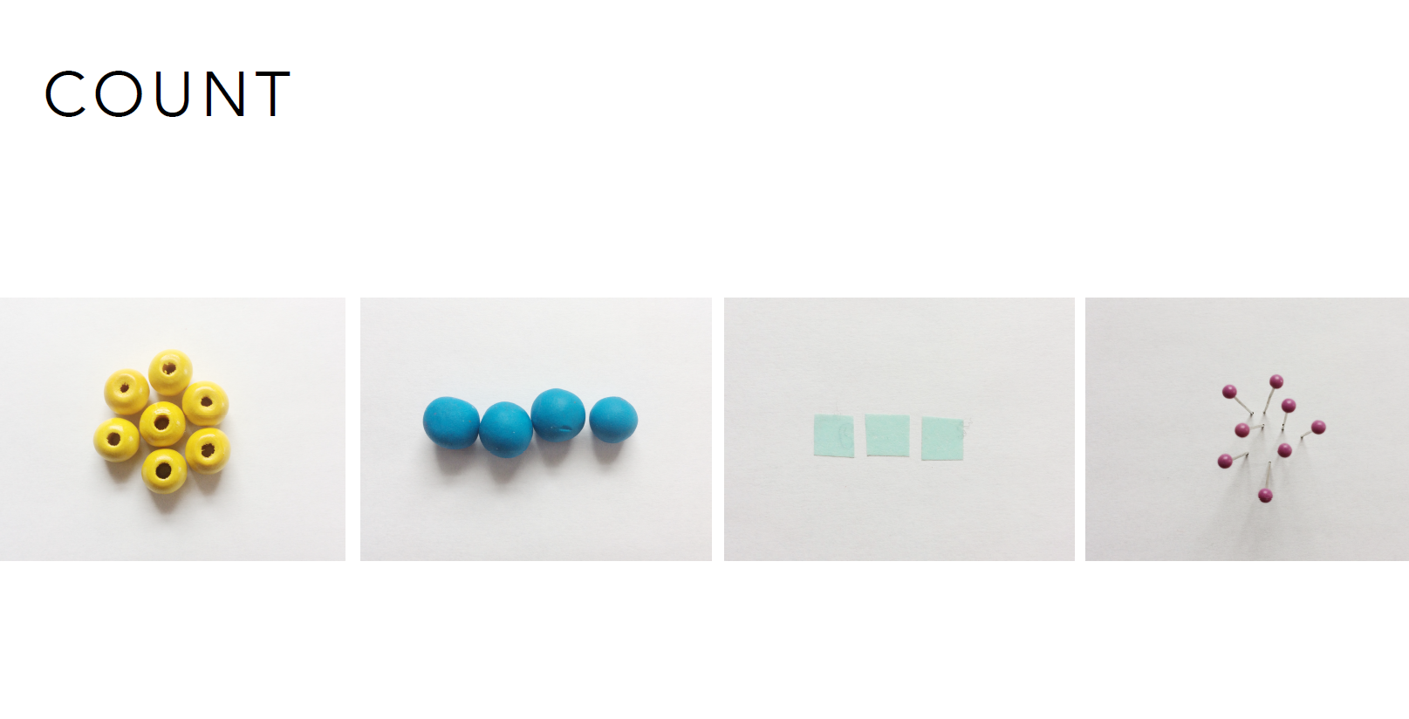
Image courtesy Alice Thudt
http://alicethudt.de/

Slide 17
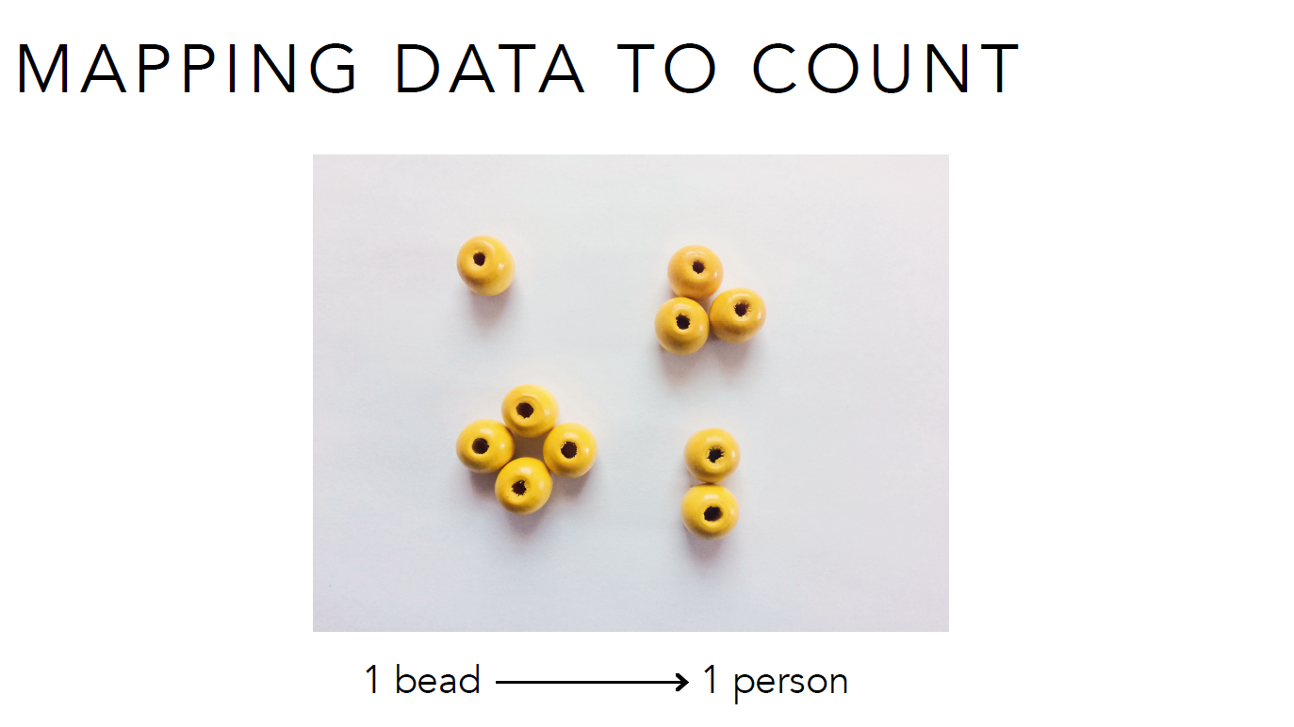
Image courtesy Alice Thudt
http://alicethudt.de/

Slide 18
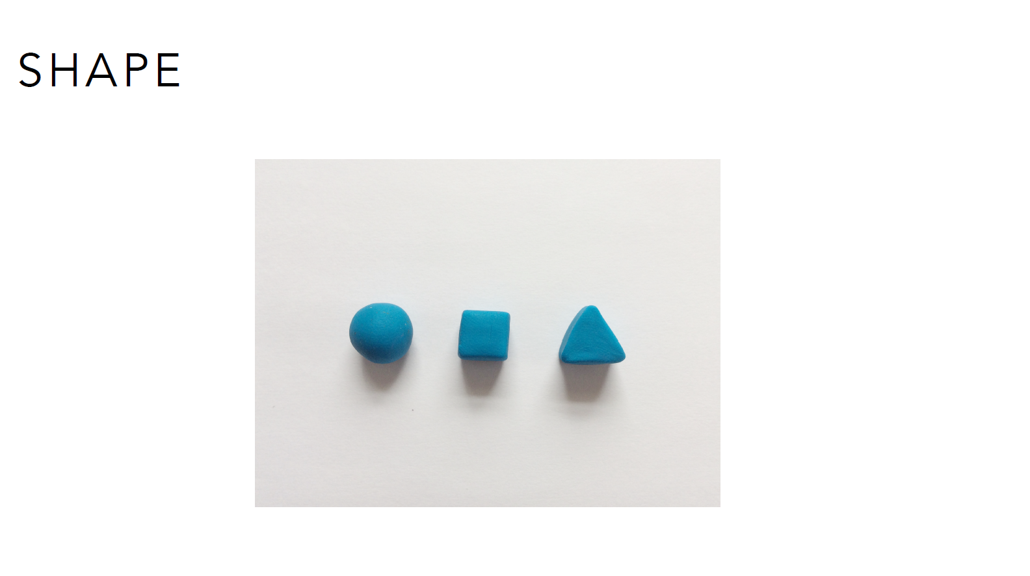
Image courtesy Alice Thudt
http://alicethudt.de/

Slide 19
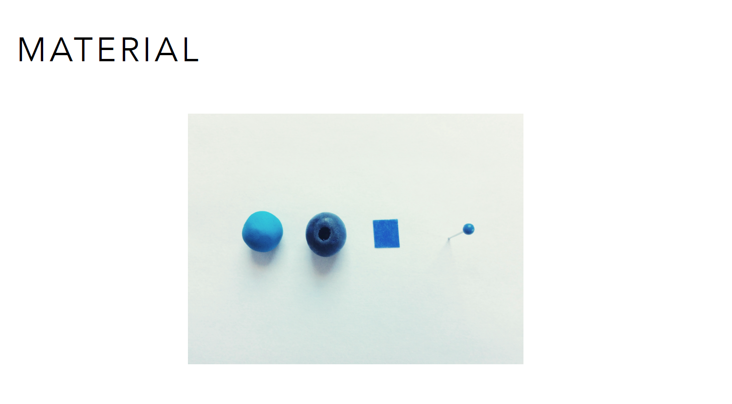
Image courtesy Alice Thudt
http://alicethudt.de/
Notes:
We can mix variables

Slide 20
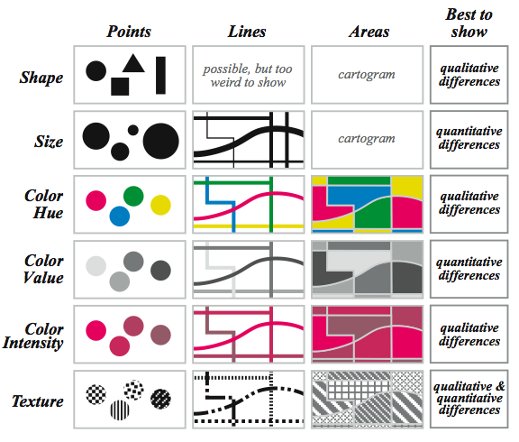
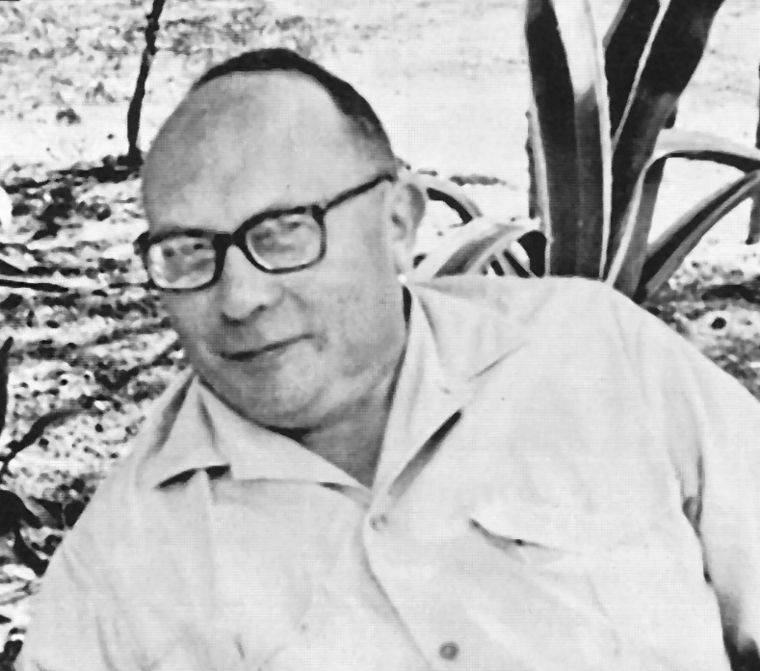

Slide 21
Go beyond
the previous variables and explore
Haptic / Feel / Touch
Dimensionality
Sensorial experience
...
Notes:
BETTINA - And explore the haptic/feel/tocuh of the materials and how that might represent the data, how can multidimensionality support the data visualisation, but also explore other sensorial aspects of the materials -- just visual/haptic or smell/taste etc.

Slide 22
Hands-on activity Make your own physical representation of data!

Slide 23
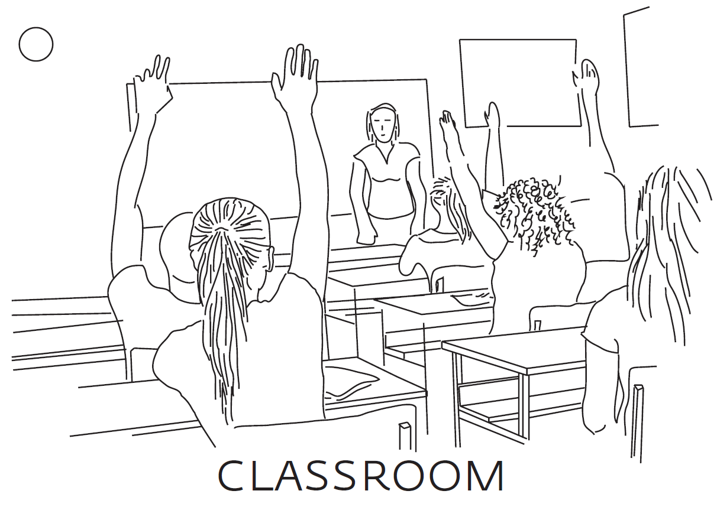

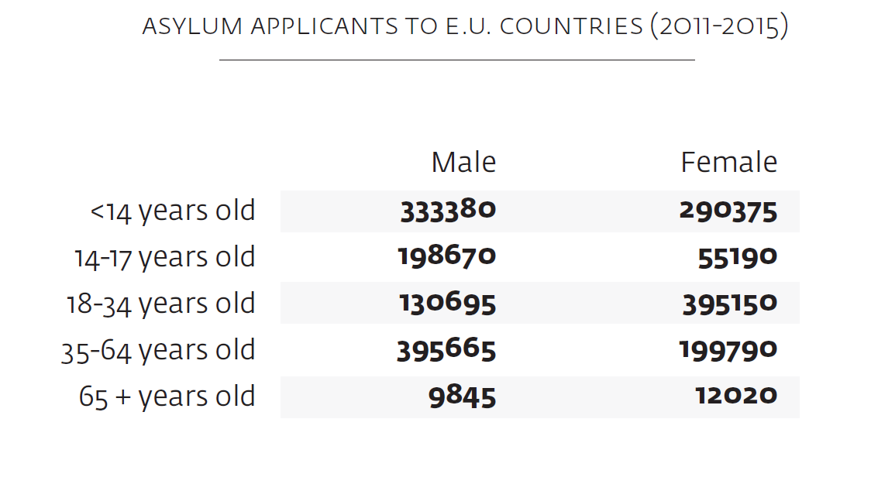

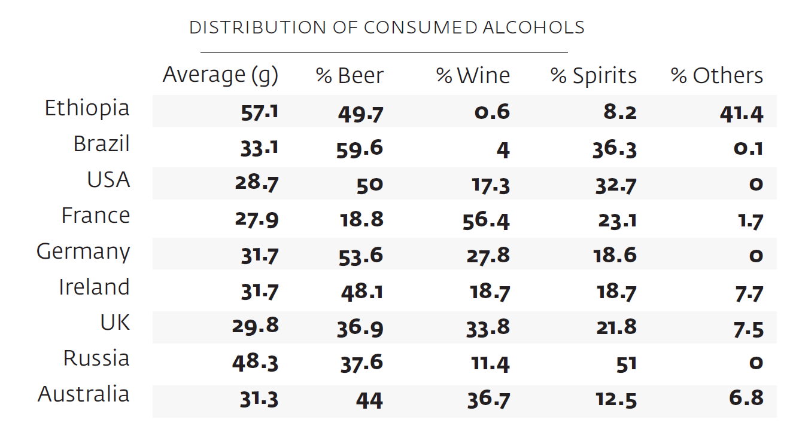
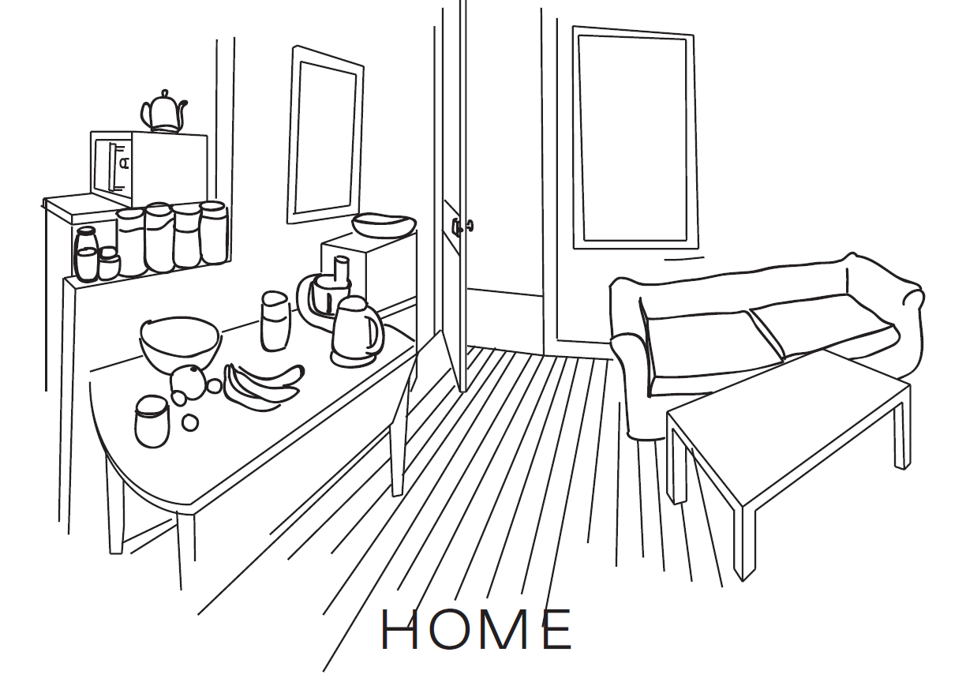
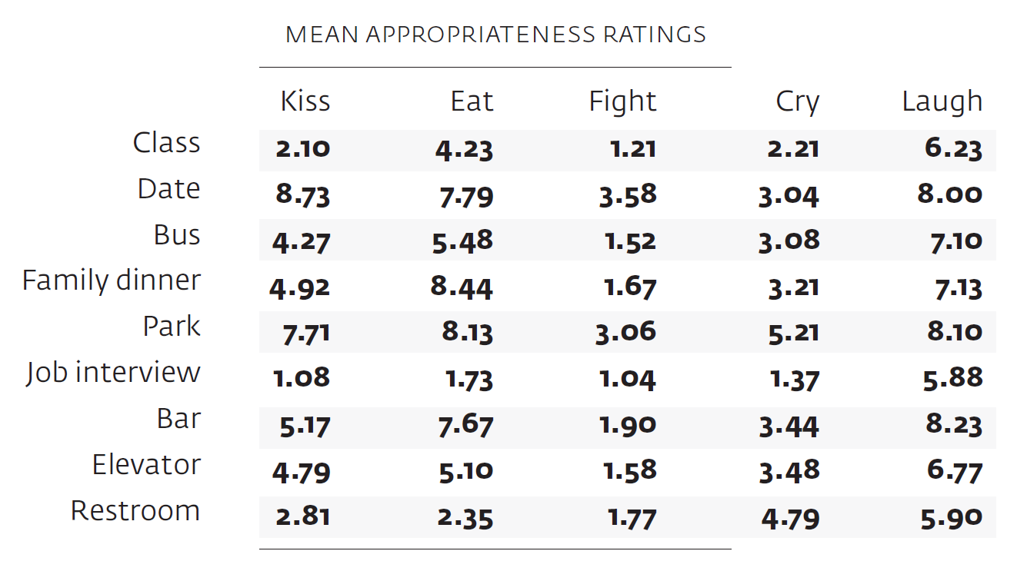
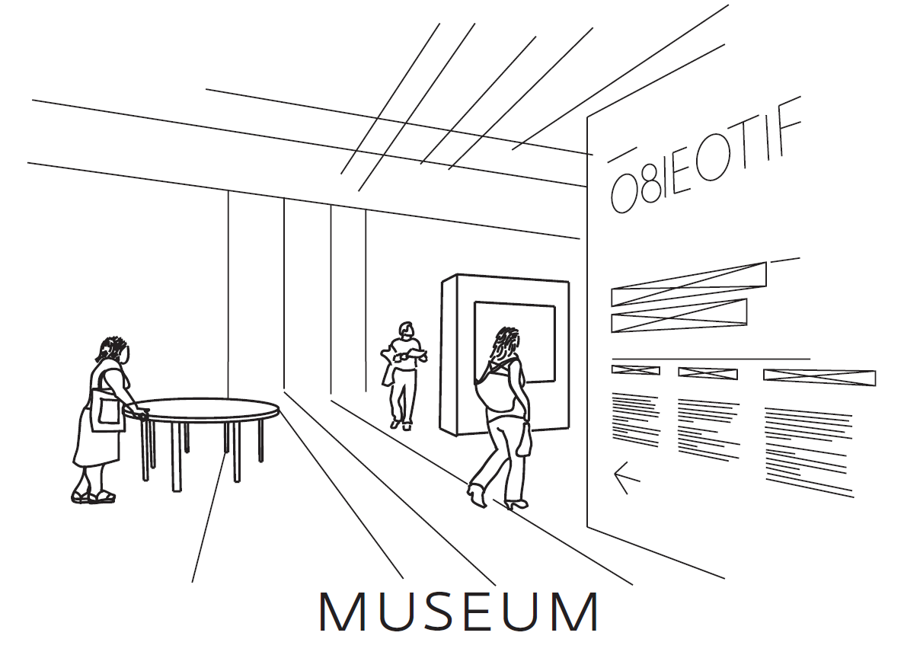

Hands-on activity constraint-driven design of data physicalization
Scenarios
Activities
Data

Slide 24
Questions to guide activity
How would you describe the physical properties of your physicalization? Which of these are directly related to data?
How would you characterize your design process when mapping your data to physical properties/form/material?
What is the role of performance / interaction / narrative in your physicalization?
What types of materials did you choose for your physicalization and why? How did your choice of materials influence the modality of your physicalization?
What is the intended type of experience you wish to facilitate with your physicalization?
Can you explain the semiotic connection (symbolic, metaphor, analogy, allegory, designation...) between the data and your physicalization?

Slide 25
Let’s physicalise!
How to express your data in different media / materials?
Examine your data!
Explore the materials!
Consider the audience of your context!
Sketch out some ideas!
Record design decisions on post-it notes

Slide 26
Questions to guide activity
How would you describe the physical properties of your physicalization? Which of these are directly related to data?
How would you characterize your design process when mapping your data to physical properties/form/material?
What is the role of performance / interaction / narrative in your physicalization?
What types of materials did you choose for your physicalization and why? How did your choice of materials influence the modality of your physicalization?
What is the intended type of experience you wish to facilitate with your physicalization?
Can you explain the semiotic connection (symbolic, metaphor, analogy, allegory, designation...) between the data and your physicalization?

Slide 27
Presentations
Notes:
Add reflections during presentation/discussions

Slide 28
Reflections
What types of materials did you choose for your physicalization and why?
How did your choice of materials influence the modality of your physicalization?
Can your physicalization be appreciated without generating any data insight?
How important is aesthetics in your physicalization?
Can your physicalizations be read without touching it?
Notes:
Add reflections during presentation/discussions

Slide 29
References
Let’s Get Physical: Promoting Data Physicalization in Workshop Formats. S Huron, P Gourlet, U Hinrichs, T Hogan, Y Jansen. Pictorial at ACM DIS 2017, June, Edinburgh. Constructing visual representations: Investigating the use of tangible tokens. S Huron, Y Jansen, S Carpendale. IEEE transactions on visualization and computer graphics 20 (12), 2102-2111
Constructive visualization. S Huron, S Carpendale, A Thudt, A Tang, M Mauerer. Proceedings of the 2014 conference on Designing interactive systems, 433-442
Data Sensification, beyond representation modality, toward encoding data in experience. T Hogan, Proceedings of the 2018 DRS.
Pedagogy & Physicalization: Designing Learning Activities around Physical Data Representations. T Hogan, U Hinrichs, Y Jansen, S Huron, P Goulet, E Hornecker, B Nissen. Proceedings of 2018 DIS.
Data-Things: Digital Fabrication Situated within Participatory Data Translation Activities, B Nissen, J Bowers. Proceedings of the 2014 conference on CHI, 2467-2476.
Notes:
Do at lunch time...

